Slide 1
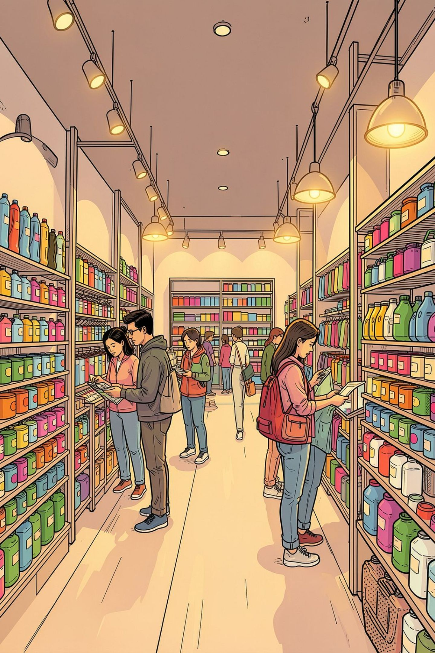
Customer Shopping Behavior Analysis
3,900 transactions · 18 features · Python · SQL · Power BI

Slide 2

Dataset at a Glance
3,900
Purchases
18
Features
37
Missing Values
Review Rating only
$59.76
Avg Purchase

Slide 3


Data Preparation in Python
Clean & Load
Imputed missing Review Ratings by category median
Engineer Features
Created age_group and purchase_frequency_days
Load to DB
Cleaned DataFrame loaded into PostgreSQL

Slide 4
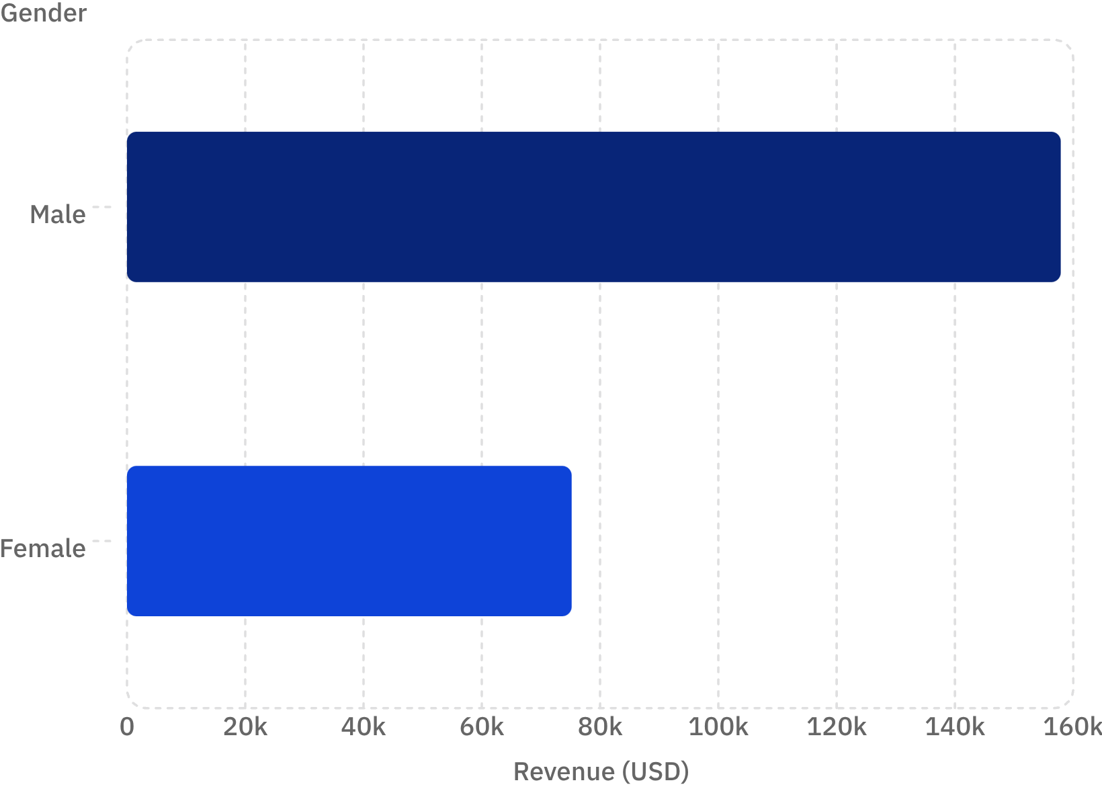

Revenue by Gender
Key Finding
Male customers generated 2.1× more revenue than female customers — a significant gap worth investigating.
Male: $157,890 · Female: $75,191

Slide 5
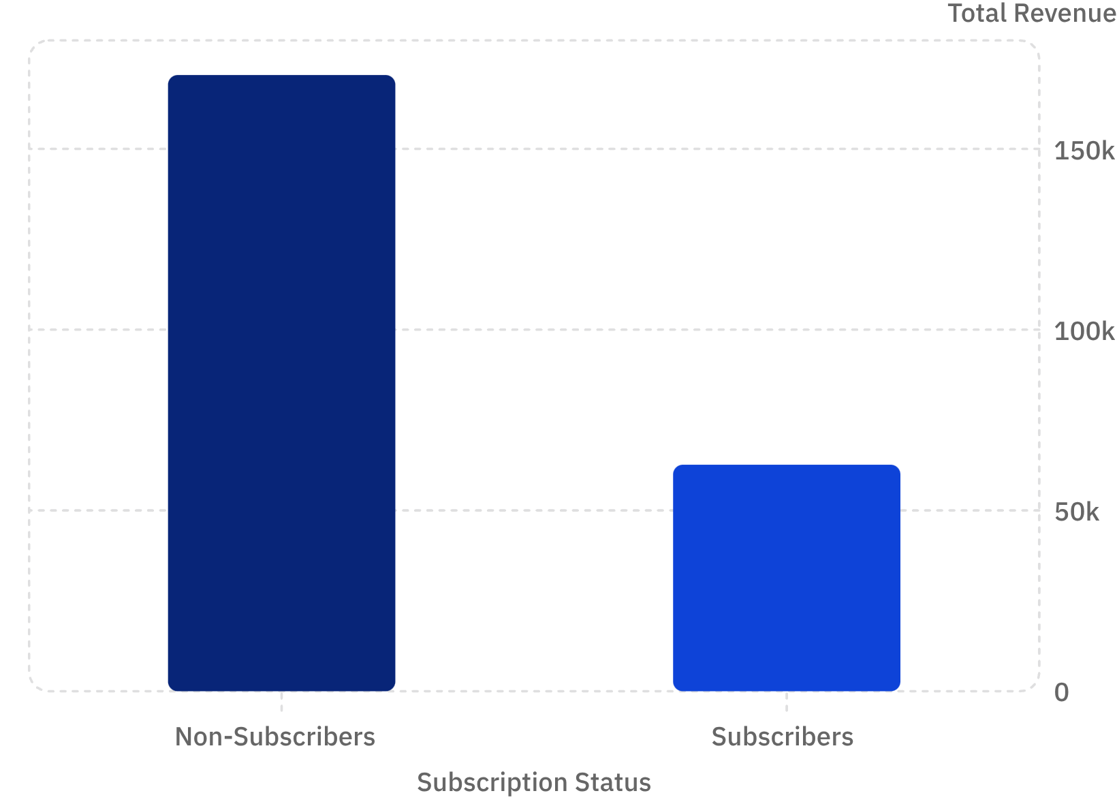
Subscribers vs. Non-Subscribers
73% Non-Subscribers
27% Subscribers
1,053 customers · $63K revenue
2,847 customers · $170K revenue
Average spend nearly identical: $59.87 vs $59.49

Slide 6
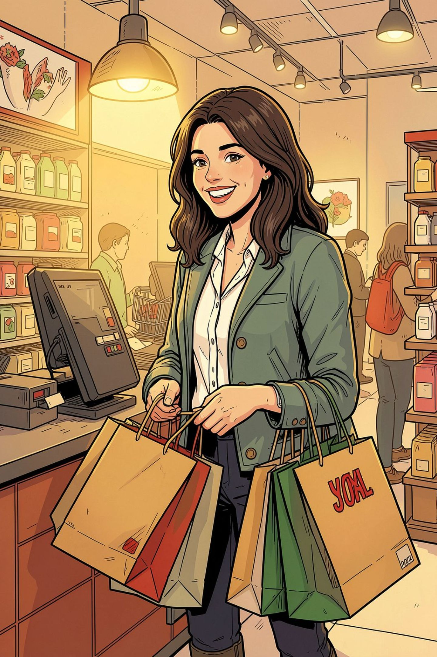
Customer Segmentation
🏆 Loyal
🔄 Returning
3,116 customers
701 customers
🆕 New
83 customers
Of 958 repeat buyers (>5 purchases), only 27% are subscribers — 73% remain unsubscribed.

Slide 7
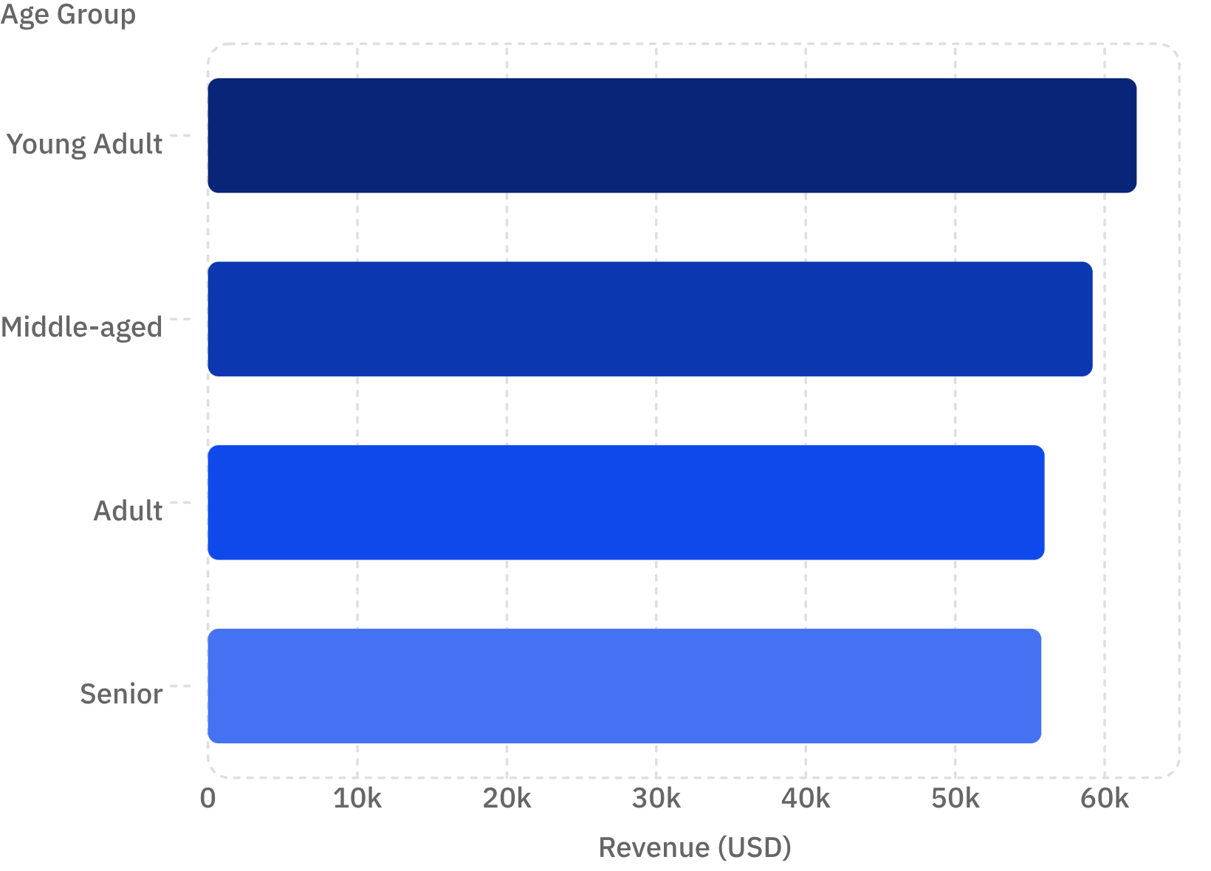
Revenue by Age Group
Insight
Young Adults lead revenue at $62K, but all four groups are closely clustered — broad targeting works.

Slide 8

Top Products & Discount Patterns
Highest Rated
Most Discounted
Gloves — 3.86★
Hat — 50%
Sandals — 3.84★
Sneakers — 49.7%
Boots — 3.82★
Coat — 49.1%

Slide 9
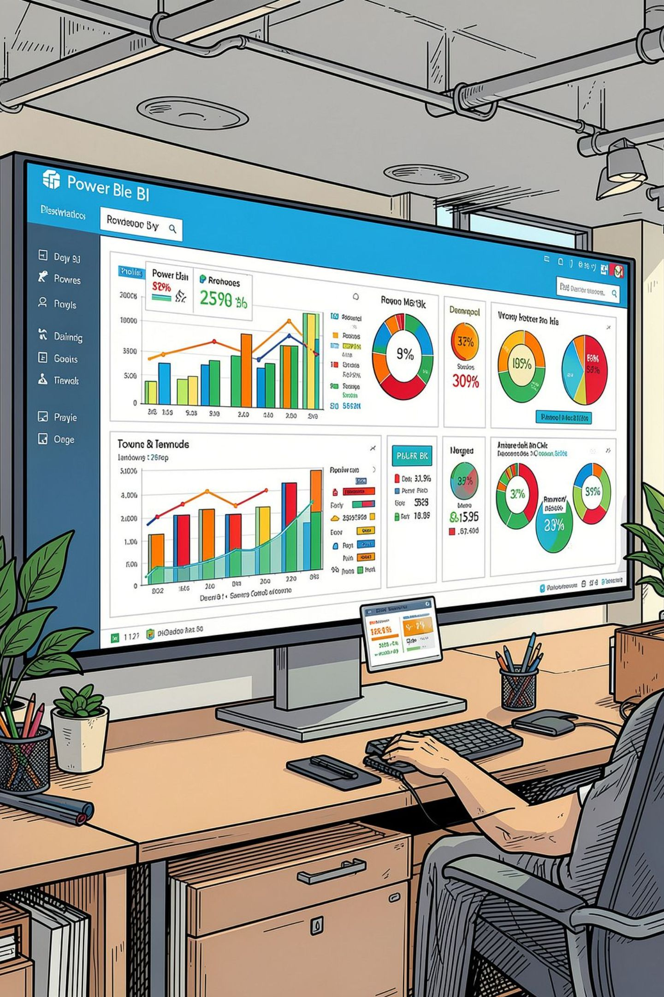
Power BI Dashboard
3.9K Customers
$59.76 Avg Purchase
3.75 Avg Rating
Clothing Dominates
$100K revenue · 1,800 sales
Filters: Subscription · Gender · Category · Shipping Type

Slide 10




Business Recommendations
Boost Subscriptions
Loyalty Programs
Promote exclusive subscriber benefits
Reward repeat buyers toward Loyal segment
Review Discounts
Targeted Marketing
Balance sales lift with margin control
Focus on high-revenue age groups & express shippers

